Slide 1
Airbnb
Listing Prices
Keqin Cao

Slide 2
Introduction
Goal: Create a model that can predict the listing price of an Airbnb listing for hosts in San Francisco.
Notes:
J

Slide 3
Why this is important:
Airbnb could apply this and give a “recommended” listing price to hosts
Potential hosts could then see this “recommended” price and persuade them to try listing
Outside of Airbnb, it shows market value of space in San Francisco (rooms, entire homes, etc) which could then be used by competitors (e.g. Marriott Homes & Villas)
Notes:
J

Slide 4
2. Dataset
From Inside Airbnb (which pulls from the Airbnb website)
Compiled March 6th, 2019
Notes:
J

Slide 5
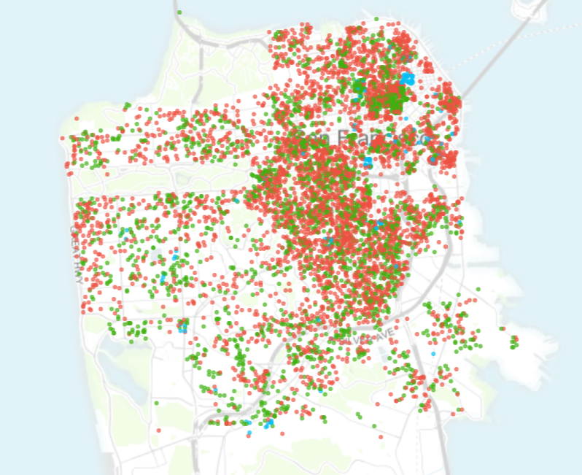
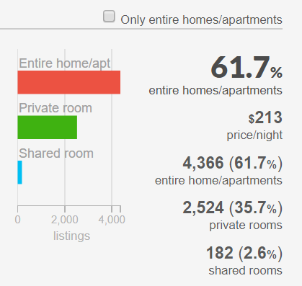
Notes:
J

Slide 6
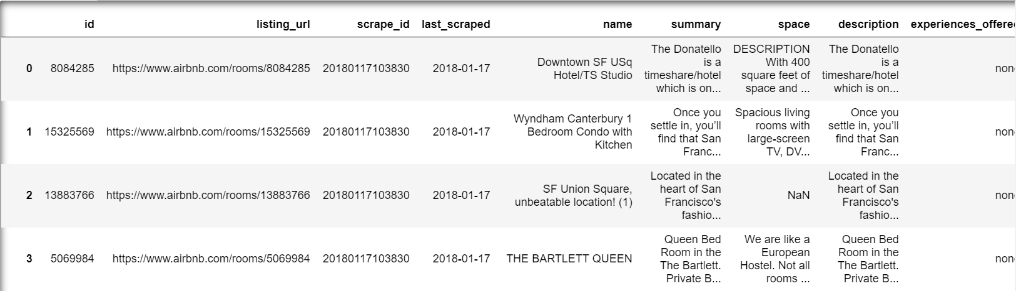
Listings Dataset
Features: ['id', 'last_scraped', 'host_total_listings_count', 'host_identity_verified', 'neighbourhood_cleansed', 'latitude', 'longitude', 'property_type', 'room_type', 'accommodates', 'bathrooms', 'bedrooms', 'beds', 'bed_type', 'amenities', 'square_feet', 'minimum_nights', 'cancellation_policy', 'is_business_travel_ready', 'cleaning_fee', 'price']
Notes:
J

Slide 7
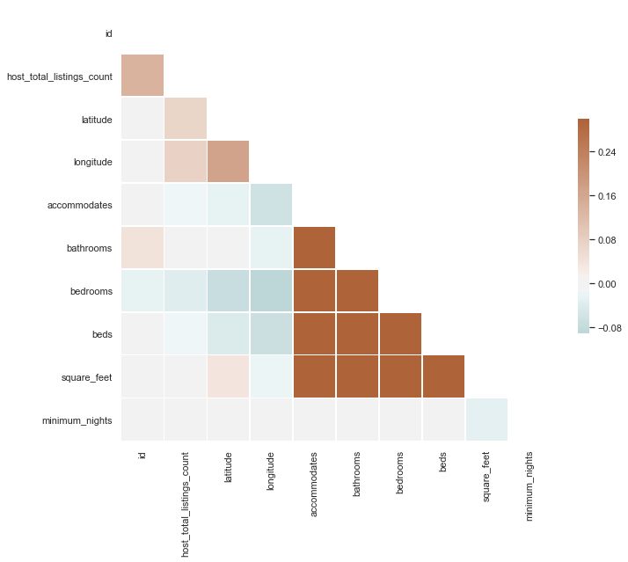
Notes:
A

Slide 8
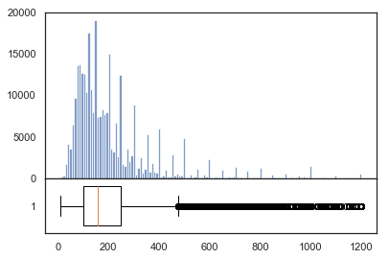
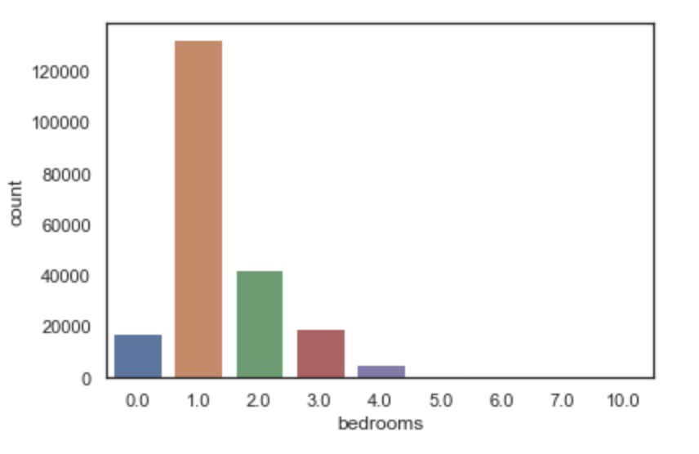
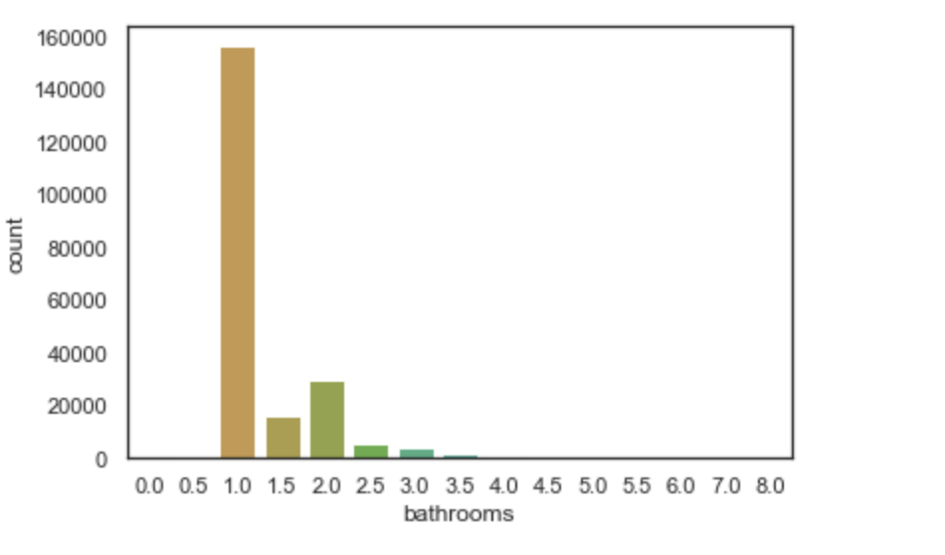
EDA and pre-processing
Regex
-removed $ signs
-removed commas in integers values
3,000 －> 3000
-converted numbers into ‘numeric’ types (floats and ints)
One-hot encoding
Outliers
-removed outliers (took 99th percentile of numeric data - price and cleaning fee, but above $1)
Removing Missing values
-removed columns that were majority NA values (3 features)
Notes:
A

Slide 9
3. Approaches
Neural Networks, Random Forests,
Gradient Boosting

Slide 10
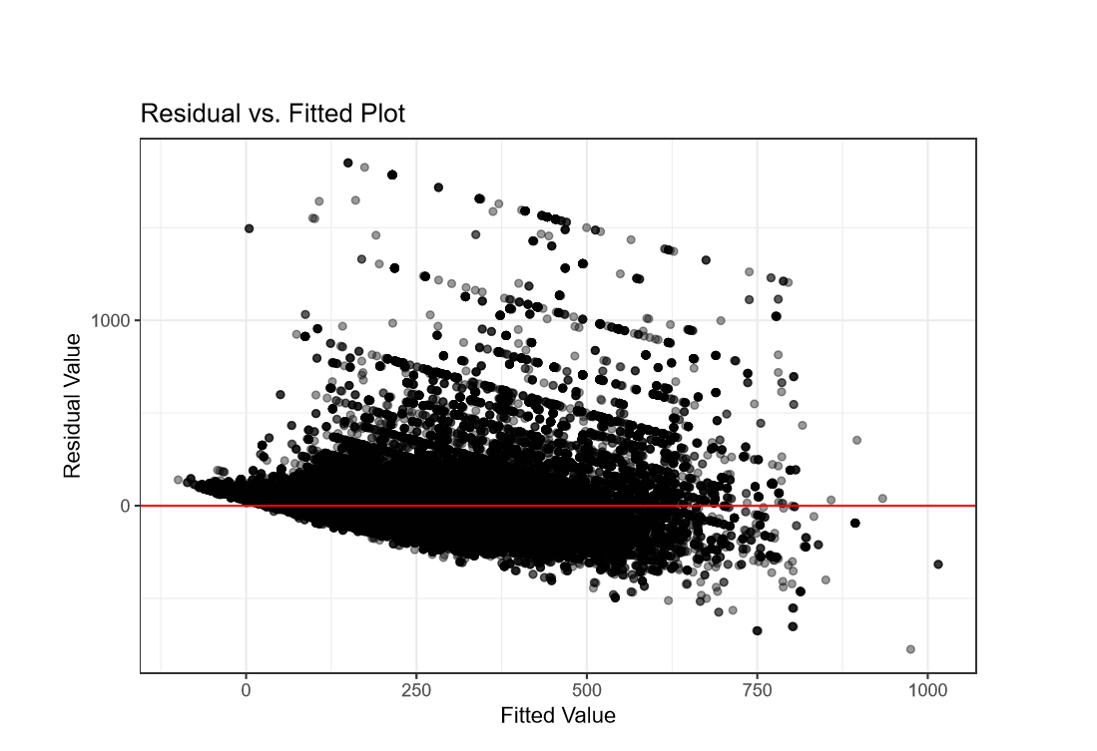
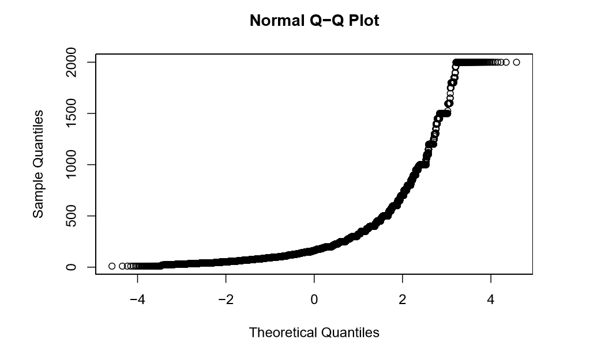
Checking linear model assumption

Slide 11
Biggest obstacles
😭
- “Duplicate” listings
- Finding a suitable error metric
Notes:
A

Slide 12
Solutions
😌
-Separate train/validation/test sets by UserID
-Split dataset by location (geographically split SF in half)
-Stratify by neighborhoods
-Train on data points from within one month
-Separate validation/test sets into two price ranges(<=300 and >300)
Notes:
T

Slide 13
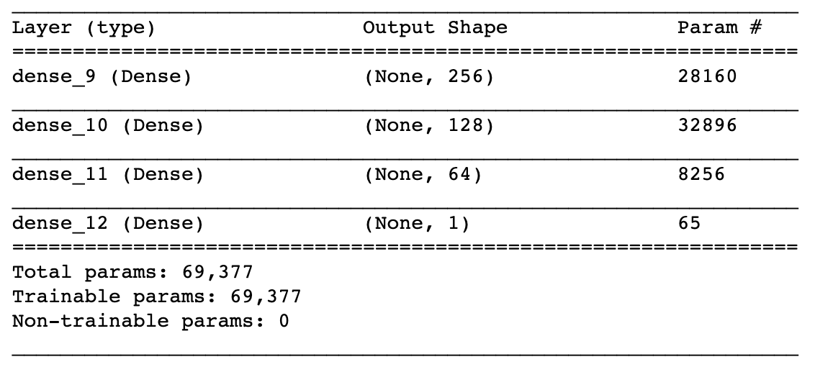
Neural Network
8 epochs
Training MAE: 105.3914
Notes:
T

Slide 14
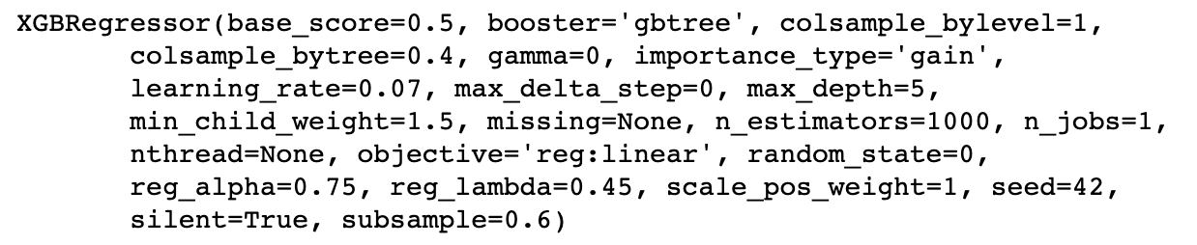
Gradient Boosting
Validation MAE:
Combined: 61.40
For prices <=300: 42.37
>300: 168.26
Notes:
T

Slide 15
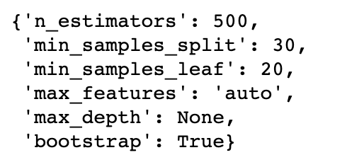
Random Forest
Without Feature Selections
Tuned hyperparameters using RandomizedSearchCV
Validation MAE:
Combined: 61.69
For prices <=300: 41.58
>300: 174.55
Notes:
T

Slide 16
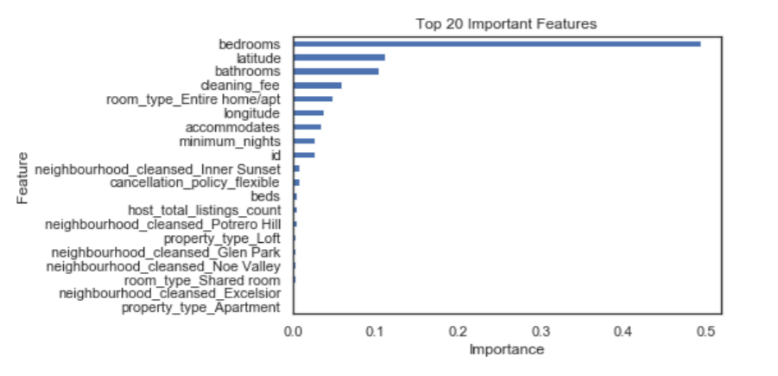
Random Forest
With Feature Selections

Slide 17
Random Forest
With Top 50 Important Features
Validation MAE:
Combined: 61.72
For prices <=300: 41.54
>300: 175.03

Slide 18
4. Test Results
Best random forest model with feature selection:
Combined MAE for test set: 66.87
For prices <= 300: 46.43
>300: 171.06
Notes:
T

Slide 19
5. Conclusion
Is it ready to be used?
I am not satisfied.
Notes:
J

Slide 20
6. Further Improvements
more data to see possible cyclical trends
only in SF
only in developed, compact urban areas
(what about suburban areas?)

Slide 21
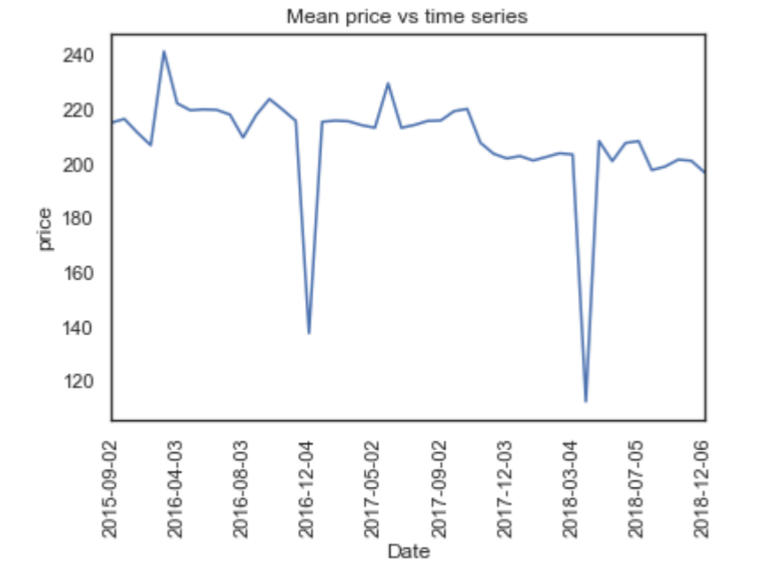
Cyclical Trends

Slide 22
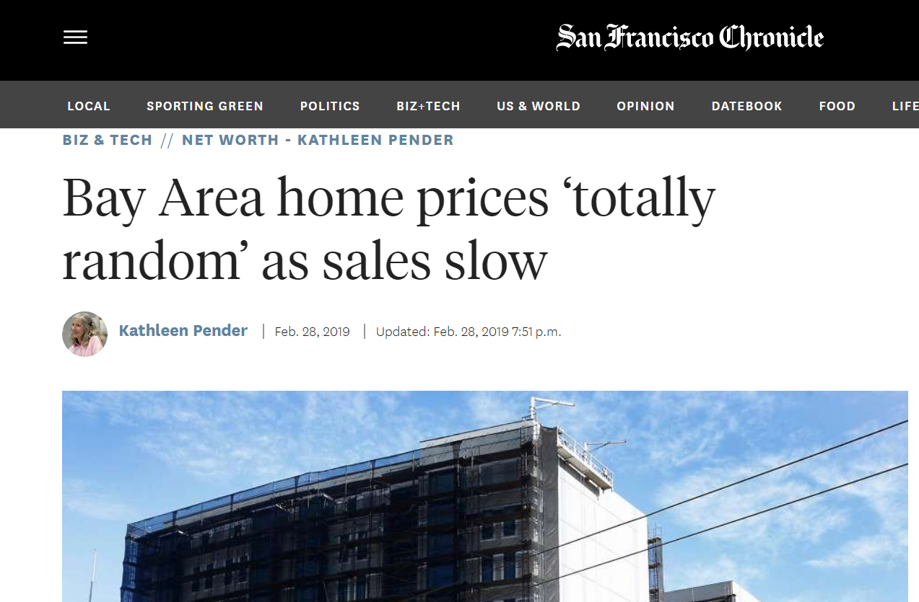
Not only is SF one of the most expensive places to live in the world, but it also has one of the most dynamic housing markets.

Slide 23

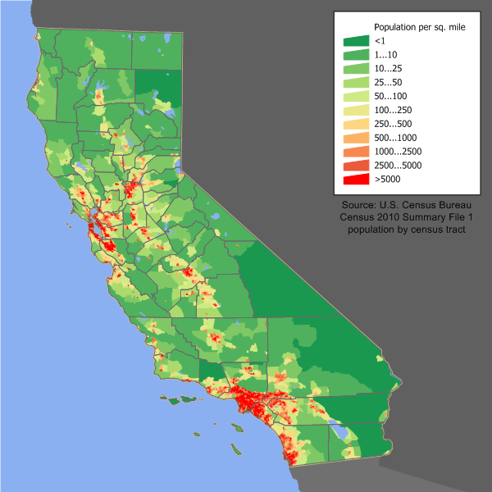
Density is a large factor in our data and model. San Francisco is incredibly packed, but it is actually less dense than some of the other major cities in the US, like Chicago, LA, or New York. What about more rural areas?

Slide 24
Thanks for listening!
What are your questions?

